Slide 1
Leicestershire SEND

Slide 2
New Developments within SENA
As part of the work we are doing in developing the quality of the SENA Service, we are reviewing all of the processes followed in SENA and any accompanying documentation.
The Service is currently being restructured with the aim of developing a better service.
We are quality assuring the samples of plans and are working with a variety of services to ensure ‘better’ advice with SMART outcomes.

Slide 3
New Developments within SENA cont
We have developed new formats that will help us gain information and share information better.
We have designed a new format of EHCP with much clearer links between need, provision and outcomes.
We have designed a new referral for assessment template to ensure we collect more information about the c/yp
We have designed a new Annual Review form that will inform any amendments required
We have also designed a new Request for Information form for our advice givers

Slide 4
High Needs Funding Top up funding
Part of our examination of the ‘effective use of funding’ we as a local authority are doing, has related to both EHCP’s (Education, Health and Care Plan) and Top-Up funding. We recognise the lack of clarity for schools in terms of requesting the most appropriate route of support and also recognise the inconsistencies within the service, including transparency of decision making and our response times.
Our aim:
To develop a transparent, consistent and timely process that provides the most appropriate funding stream to support the child or young person.

Slide 5
Funding Reminder:
Element 3 is all money from the High Needs Block which means both through Top Up Funding or through EHCP - Schools have to demonstrate that the provision needed is greater than can be supported through Element 1 and 2 funding
ISSUES:
Currently the threshold for both is the same
Provision is given in hours of LSA support regardless of need
All Element 3 funding is nationally known as Top Up funding… but not in Leicestershire!

Slide 6
High Needs Funding – Our Long Term Aim
Long term we are looking to develop a ‘banding model’ which will move away from identifying provision in terms of number of hours but instead by an amount of funding. The level of funding will relate directly to the degree of needs. Schools can then manage these funds directly to meet the needs of the c/yp. This system will be entirely transparent and will ensure consistency and allow schools a degree of flexibility in providing most appropriate provision.
We recognise that funding can be used to support focused intervention which can narrow the gap between the c/yp and their peers which can in turn prevent a long term need which is likely to have impact adulthood.

Slide 7
Top Up Funding to cease…
To address confusion over terminology of what Top Up funding is, name changing to SEND Intervention Funding
Develop clear guidance for schools
Change process to ensure timely response
Change process to ensure an ‘easier’ application
Ensure effective comms with schools to ensure schools are clear about the specific and time bound intervention they wish to put in place and the anticipated outcome
Ensure schools fully cost out interventions and demonstrate how they will spend the funding
… and SEN Intervention Funding introduced

Slide 8
SEND Intervention Funding or EHC Plan ? We recognise that funding can be used to support focused intervention which can narrow the gap between the c/yp and their peers, which may prevent the need for an EHCP.

Slide 9
SEND Intervention Funding or EHC Plan ? SEN intervention funding may be appropriate when longevity of need is not known or there are environmental factors affecting presentation. Examples: * a young child or newly identified need * need for support during up and coming transition times (starting school and moving to high school) * an environmental change in family circumstances that may be impacting on performance such as bereavement or frequent change of school

Slide 10
New Request for EHC Needs Assessment

Slide 11
New Request for EHC Needs Assessment

Slide 12
New Request for EHC Needs Assessment

Slide 13
New Request for EHC Needs Assessment

Slide 14
New Request for EHC Needs Assessment

Slide 15
New Request for EHC Needs Assessment

Slide 16
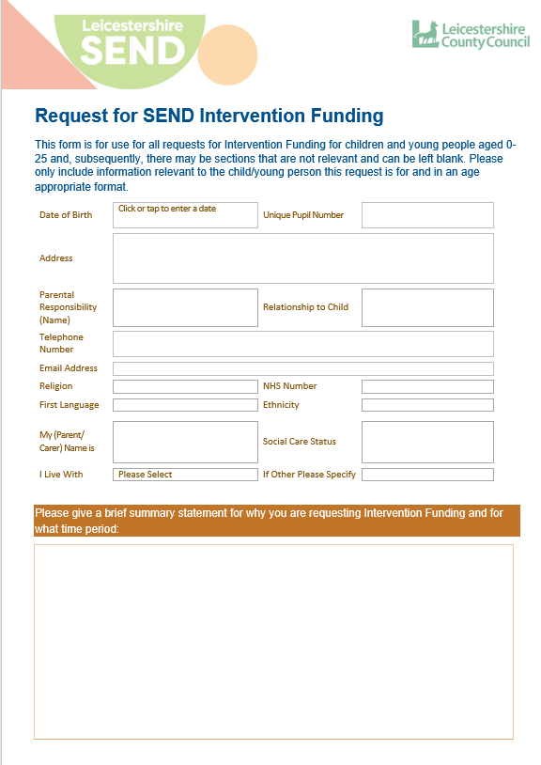
New Request for SEND Intervention Funding

Slide 17
New Request for SEND Intervention Funding

Slide 18
New Request for SEND Intervention Funding

Slide 19
New Request for SEND Intervention Funding

Slide 20
Q&A

