Slide 1
What does SEND good practice look like in schools for students with challenging behaviour arising from SEMH?
How can we best promote that good practice with our colleagues in schools?
This was prepared by Sarah Anderson and Anna Tyers
Woodbrook Vale School for the five Secondary Education and Inclusion Partnerships in Feb 2021. It should be used in conjunction with the Continuum of Support to guide us all in ensuring that schools and colleges are effective in developing support for individual learners prior to referring for Partnership support.

Slide 2
Good practice for SEMH students is good practice for all students. The school ethos needs to be Inclusive.
All systems, policies, and procedures need to reflect the needs of all learners.
All staff need to know all students and their strengths, needs and difficulties.
Transition at KS2-3, 3-4 and Post 16 needs to be carefully planned and supported.
All teachers are teachers of students with SEND.

Slide 3
A graduated approach following Assess, Plan, Do, Review
Students with identified SEMH needs should be K category and there should be a good link between the LIP link and the SENDCO.
2015 SEND Code of Practice: 0-25 years
Where a pupil is identified as having SEN, schools should take action to remove barriers to learning and put effective special educational provision in place.
This SEN support should take the form of a four-part cycle through which earlier decisions and actions are revisited, refined and revised with a growing understanding of the pupil’s needs and of what supports the pupil in making good progress and securing good outcomes.
This is known as the Graduated Approach.

Slide 4

The Graduated Response

Slide 5
Code of Practice: Chapter 6. SEMH
6.32 Children and young people may experience a wide range of social and emotional difficulties which manifest themselves in many ways. These may include becoming withdrawn or isolated, as well as displaying challenging, disruptive or disturbing behaviour. These behaviours may reflect underlying mental health difficulties such as anxiety or depression, self-harming, substance misuse, eating disorders or physical symptoms that are medically unexplained. Other children and young people may have disorders such as attention deficit disorder, attention deficit hyperactive disorder or attachment disorder.
6.33 Schools and colleges should have clear processes to support children and young people, including how they will manage the effect of any disruptive behaviour so it does not adversely affect other pupils.

Slide 6
Good practice consists of:
A clear shared vision and ethos
Clear communication
Clear and consistent information sharing
Established and consistent processes/systems in place
Strong relationships between staff and pupils
Restorative approaches embedded
Early identification of needs
Early support and graduated response: Assess, Plan, Do, Review
Clear signposting to appropriate specialist support

Slide 7
Evidence based
Good relationships are key to establishing engagement in learning
EEF report (‘Improving behavior in schools; 2019) suggests 6 key points for improving behaviour:
Know and understand your pupils
Teach learning behaviours alongside managing misbehaviour
Use classroom management strategies to support good classroom behavior
Use simple approaches as part of your regular routine
Use targeted approaches to meet the needs of individuals in your school
Consistency is key

Slide 8
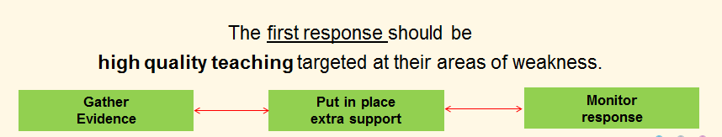
What we do in the first instance…
Best Practice in Schools

Slide 9

Gathering evidence
Checklists/observations/discussions with teachers
Discussions with parents
Criterion referenced tools
Assessment of social, emotional and behaviour development
2 part checklist
Identifies levels of skills to access learning
Strengths and Difficulties Questionnaire (SDQ)
Discussions with pupils
Feedback from form tutor/Head of Year
Records of behavioural incidences/concerns

Slide 10
Planning Provision to meet Outcomes: what is the desired outcome for the pupil? Clear focus is needed.
Sharing good practice, up to date CPD on teaching and learning, sharing strategies through pupil postcard
1. Quality First Teaching
Quality First teaching, differentiated for individual pupils,
is the first step in responding to pupils who have SEMH needs.
2. Targeted Provision
Teacher and SENCO should agree in consultation with the parent and the pupil the adjustments, interventions and support to be put in place, as well as the expected impact on progress, development or behaviour, along with a clear date for review
Notes:
Focus of planning – 2 areas: QFT and Targeted Provision
Traditionally, more focus on TP than on QFT.
Need at least equal focus on both.
Implications for the focus of SENCo’s conversations with teachers and departments and also the increased expectation on teachers? …

Slide 11

Clear Communication: Sharing information to inform QFT: the ‘Pupil Postcard’
Relationships, communication, giving staff the right information and being consistent are important.
Preparing an easy to reference document, taking into account the pupil’s views, therefore ensuring a child-centred approach, is essential.
Pupil postcards are attached to the school’s go4schools system.

Slide 12
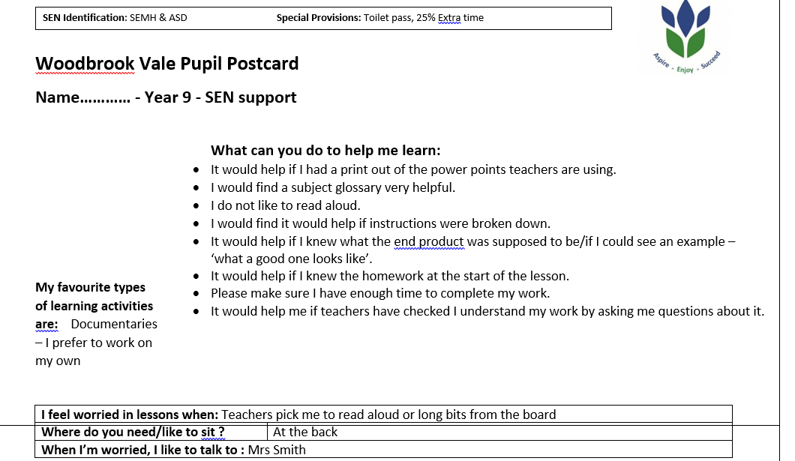

Pupil Postcards for QFT
Sharing information
Developing relationships
Making the student feel valued – creating a sense of belonging
An example of information exchange used effectively at Woodbrook Vale School

Slide 13
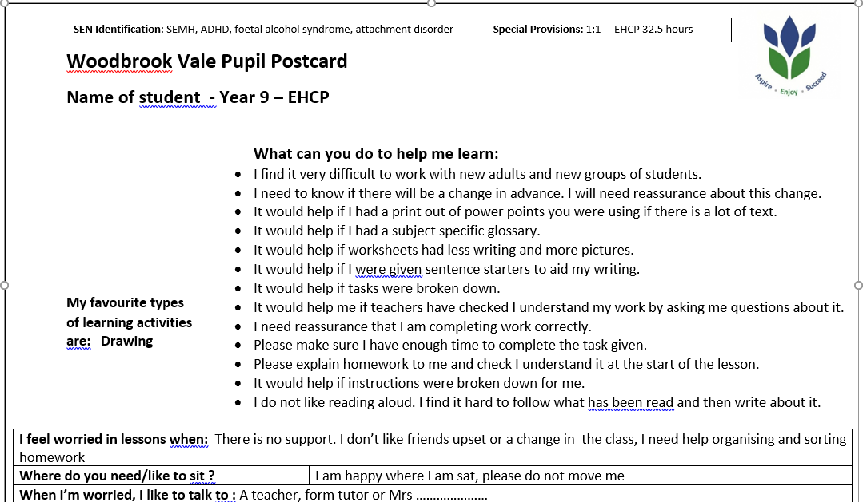

Using the postcard to plan effective QFT
Knowing about changes to the norm are important for this student. The teacher being aware of this helps prevent a lot of stress/anxiety.
This student will need extra time.
There are clear strategies that are easy to use within the lesson that will lessen the anxiety the student faces.

Slide 14

Continual sharing information and communication with staff, parents and pupils is key to targeted provision
Be aware of suitable interventions
Monitor progress of targeted support/intervention
Review the targeted support/intervention regularly
Try a different intervention, try and improve, constant assess plan do review, ask for advice monitor anything done – impact/effect if not working, try something else
Share ideas
Feedback and monitor

Slide 15
Growing
Understanding of what approaches secure better outcomes
Growing
Understanding of
Pupil’s strengths and Needs
Assess
Plan
Do
Review
REVISE
REVISIT
More detailed & specialist
approaches
More frequent reviews
REFRESH
Growing
Understanding of what teaching approaches work and don’t work
Growing
Understanding of
effective support
REFINE
From this we have…

Slide 16
Case studies: KS3 Student
Needs: SEN – SEMH C&L, C&I
This student has significant SEMH needs, together with cognition and learning needs and language delay. She is currently working at levels significantly below her chronological age. These needs are further compounded by her attachment difficulties, fragile self image, developmental immaturities and her difficulties understanding and managing social relationships with peers and adults, making her socially vulnerable. She has little resilience and has extreme emotional reactions to situations she perceives as challenging. It subsequently takes a considerable amount of time to calm her and re-engage her with learning. She is easily distressed and struggles with what she perceives as loud noises, displaying extreme reactions to film clips, music lessons ad classroom discussions. She repeatedly complains of headaches, stomach ache and feeling sick alongside displaying anxious behaviours throughout the school day. She also becomes anxious when it is time to go home.
2020/2021 Attendance data | ATL | Stages | Exclusions/ Hosts
Attendance to all entered exams (5)
Engagement with 1:1 tutor
Relatively high attendance[MRM1] prior to personalised timetable
Able to access curriculum due to adjustments made
Completed application for Post-16 course
Accepted on to a college Course - Loughborough College, Motor Mechanics
Achieved GCSE grades in English Language, maths, Science and statistics
Achieved grade 2 in English Language
[MRM1]Is there any patturn? E.g. what was his attendance like before his tutoring? Was it higher because he was in school all the time

Slide 17
Take 5 minutes to consider:
What are the issues for this student?
What QFT needs to be in place?
What additional interventions should be used?
What could be the next steps?

Slide 18
Graduated Response
Student was identified at transition as possibly needing support, previous SEMH concerns, some ASD tendencies, previously referred to CAMHs, working below chronological age
Information used to produce pupil postcard in conjunction with the student – this was shared prior to students starting at WBVS
Information on students needs shared in virtual pre-recorded presentation with all staff.
Transition support following normal procedures unable to take place however virtual support and ASD friendly information shared
Student placed into tutor group with other students with an EHCP so support would be available throughout the day
Nurture room available and student accessed daily
Early observations and teacher and LSA feedback indicated concerns regarding behaviours and ability to cope with the demands of the school day
Googlesheet introduced to track access to learning, behaviours and response to support – shared with LSA staff, tutor, HOY and SENDCo
Time out card issued and suggested use of the learning zone when student feeling overwhelmed
Feedback and observation indicated further differentiation needed within lessons including language used to interact with student
SENDCo made further contact with feeder school to discuss strategies that worked in previous setting. These were put into place and shared with staff.
SENDCo began regular contact with home and suggested parent take student to GP
1:1 support needed to support student throughout the day
SOCCs, social stories and restorative practice used regularly to support student’s understanding of behaviour and peer interaction
RAG cards introduced
NGRT indicated student working at level significantly below chronological age
SpLD assessment to determine nature of C&L difficulties which could be contributing to observed behaviours and SEMH difficulties
Student unable to complete assessments with SpLD assessor and extreme emotional responses observed
EP referral to determine SEMH needs and strategies to support
Think Good Feel Good CBT intervention in place to support emotional regulation
Fresh Start intervention in place to support C&L needs
Friendship group in place to support appropriate interaction with peers
EHCP application

Slide 19
Support/Intervention in place
Pupil postcard in place, shared with staff and reviewed termly
One page profile and EHCP shared with staff
Key worker to oversee and up to three different LSAs working with her
Visual timetable
RAG cards
Termly review meetings with parent/guardian
Meetings between Deputy Head, SENCO, student and Guardian
Regular liaison with parent/guardian
1:1 Support throughout the day during lessons and unstructured times
Use of learning zone for time out
Use of nurture room at break and lunchtime
Think Good Feel Good CBT intervention in place
Fresh Start Literacy and Numeracy sessions
Accelerated reader
Friendship Group
HOY mentoring weekly
Tutor time support LSA/HLTA
Provided with separate room/area for assessments
Provided with equipment
CAMHS involvement
Strategies sought from Specialist provision
Involvement from Educational Psychologist and strategies shared with staff
Access arrangements in place
Access arrangements training

Slide 20
How has intervention been adapted according to needs?
Nurture support at break/lunch is 1:1
1:1 support in a separate area in order to reduce levels of classroom disruption/ distraction.
Time out card
Provided with separate small room/space in which to undertake assessments in order to reduce anxiety.
Exam concessions of Reader/ Small Room/ Prompter
Small number of LSAs - built a positive relationship with LSAs
Support and Strategies from EP in place
Friendship group – peers very carefully selected
Student voice
Student finds it difficult to access learning at certain times of the day/struggles with sensory needs.

Slide 21
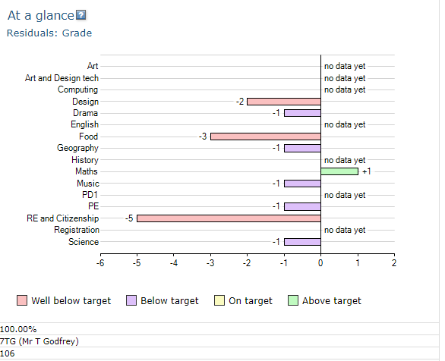
Progress and attainment
As the data demonstrates despite the graduated response and the significant interventions in place limited progress was being made.
Statutory assessment was the next step.
We were successful in this but this success was only the result of the fact that we were able to prove that despite everything in place we were having very limited impact.

Slide 22
Evidence of Impact
Working above target in latest Maths assessment
Attendance 100%
Fewer complaints of headaches/stomach aches within the same day
Positive peer interaction starting to improve
Fewer incidences of extreme reactions as evidenced by go4schools and googlesheet tracker

Slide 23
Restorative practice
Restorative Practice - YouTube

Slide 24
Summary: effective SEND provision in school
1) Co-ordinate provision and have clear systems of referral
Clear referral process
Provision Map
2) Use effective evidence based interventions
EEF is a good place to start
3) Develop on-site expertise
Balance SEND team with a range of expertise
Share knowledge through external partnerships
From a commentary by Lesley Cox and Mary Raynor in 2016
Notes:
This came from a different HMI on YouTube.

Slide 25
4) Use resources efficiently
Deploy highly trained LSAs/HLTAs effectively
Employ high quality administrative support
Use a graduated approach to interventions
5) Use rigorous assessment and identification
Ensure precise identification of SEND
Match with an appropriate intervention
Assess effectiveness of classroom teaching before deciding a child has SEND
6) Track and monitor progress
Track progress of students with SEND across different subjects
Identify patterns of achievement across different SEND groups

Slide 26
7) Evaluate the impact of interventions
Make adjustments to the provision accordingly
8) Work with pupils and parents
Ensure frequent, honest and open communication with parents
Give opportunities for pupil voice
9) Ensure strong teaching and learning
Provide a relevant, flexible curriculum
Invest in teacher development
10) Prioritise leadership of SEND
Have high expectations and ambition for all

